Slide 1
Chapter 2
The SPINE of Statistics

Slide 2
Spine?
Standard error
Parameters
Interval estimates
Null hypothesis testing
Estimation

Slide 3
Inferential Statistics
Allows researchers to make generalizations about larger populations based on data collected from a smaller sample
Why does this matter for Psychology?

Slide 4
Populations and Samples
Population (N)
  The collection of units (be they people, plankton, plants, cities, suicidal authors, etc.) to which we want to generalize a set of findings or a statistical model
Sample (n)
  A smaller (but hopefully representative) collection of units from a population used to determine truths about that population
Notes:
How do we get a sample?
How do we ensure that a sample is good?

Slide 5
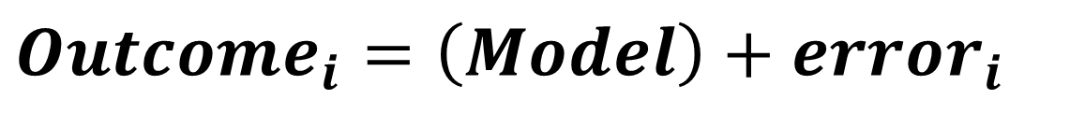
The Only Equation You Will Ever Need
$$Outcome_{i}=\left(Model\right)+error_{i}$$
Notes:
Maybe that’s a slight exageration

Slide 6
A Simple Statistical Model
In statistics we fit models to our data (i.e. we use a statistical model to represent what is happening in the real world).
The mean is a hypothetical value (i.e. it doesn’t have to be a value that actually exists in the data set).
As such, the mean is simple statistical model.
Notes:
One of the simplest models we use in statistics is the mean. Some of you may have trouble thinking of the mean as a model, but in fact it is because it represents a summary of data. The mean is a hypothetical value that can be calculated for any data set, it doesn’t have to be a value that is actually observed in the data set. For example, if we took five statistics lecturers and measured the number of friends that they had, we might find the following data: 1, 3, 4, 3, 2. If we take the mean number of friends, this can be calculated by adding the values we obtained, and dividing by the number of values measured:. Now, we know that it is impossible to have 2.6 friends (unless you chop someone up with a chainsaw and befriend part of their remains, which in practice has proved disturbing) so the mean value is a hypothetical value. As such, the mean is a model that we create to summarise our data.

Slide 7
Does mean values actually exist?
Average number of children per family in the US? 1.94
Number of books in the average American household? 113
Average number of dogs per household? 1.6
The mean is a statistical abstraction!
Notes:
One of the simplest models we use in statistics is the mean. Some of you may have trouble thinking of the mean as a model, but in fact it is because it represents a summary of data. The mean is a hypothetical value that can be calculated for any data set, it doesn’t have to be a value that is actually observed in the data set. For example, if we took five statistics lecturers and measured the number of friends that they had, we might find the following data: 1, 3, 4, 3, 2. If we take the mean number of friends, this can be calculated by adding the values we obtained, and dividing by the number of values measured:. Now, we know that it is impossible to have 2.6 friends (unless you chop someone up with a chainsaw and befriend part of their remains, which in practice has proved disturbing) so the mean value is a hypothetical value. As such, the mean is a model that we create to summarise our data.

Slide 8
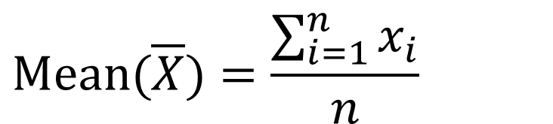
The Mean
The mean is the value from which the (squared) scores deviate least (it has the least error).
$$Mean(\overline{X})=\frac{\sum_{i=1}^{n}{x_{i}}}{n}$$

Slide 9
Measuring the ‘Fit’ of the Model (1)
The mean is a model of what happens in the real world: the typical score
It is not a perfect representation of the data
How can we assess how well the mean represents reality?

Slide 10
Measuring the ‘Fit’ of the Model (2)
How much do scores vary within a sample?
How much do scores vary from a known population?
Can we use the model to infer something about the population?

Slide 11
Samples and Populations
Sample
  Mean and SD describe only the sample from which they were calculated.
Population
  Mean and SD are intended to describe the entire population (very rare in Psychology).
Sample to population:
  Mean and SD are obtained from a sample but are used to estimate the mean and SD of the population (very common in psychology).

Slide 12

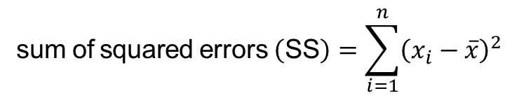
Sum of Squared Errors (SS)
Indicates the total dispersion, or total deviance of scores from the mean:
It’s size is dependent on the number of scores in the data.
More useful to work with the average dispersion, known as the variance:
$$\text{sum} \text{of} \text{squared} \text{errors} \left(\text{SS}\right)=\sum_{i=1}^{n}{{\left(x_{i}−\overline{x}\right)}^{2}}$$
$$\text{variance} \left(s^{2}\right)=\frac{\text{SS}}{n−1}=\frac{\sum_{i=1}^{n}{{\left(x_{i}−\overline{x}\right)}^{2}}}{n−1}$$

Slide 13
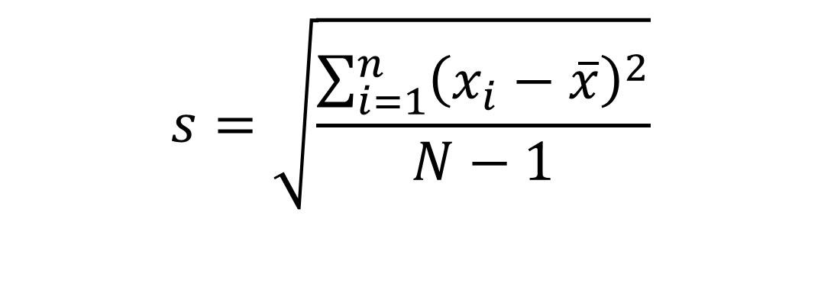
Sample Standard Deviation (S or SD)
$$\begin{matrix}s=\sqrt{\frac{\sum_{i=1}^{n}{{\left(x_{i}−\overline{x}\right)}^{2}}}{N−1}} \\ \\ \end{matrix}$$

Slide 14
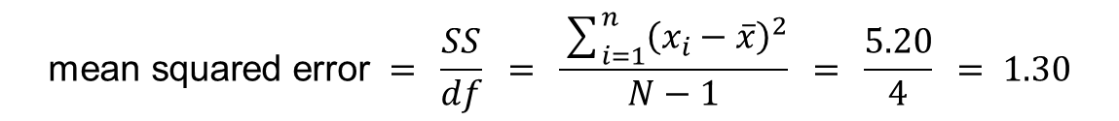

Mean Squared Error (MSE)
Although the SS is a good measure of the accuracy of our model, it depends on the amount of data collected. To overcome this problem, we use:
$$\text{mean} \text{squared} \text{error} = \frac{SS}{df} =\frac{\sum_{i=1}^{n}{{\left({\text{outcome}}_{i}−{\text{model}}_{i}\right)}^{2}}}{N−1}$$
$$\text{mean} \text{squared} \text{error} = \frac{SS}{df} = \frac{\sum_{i=1}^{n}{{\left(x_{i}−\overline{x}\right)}^{2}}}{N−1} = \frac{5.20}{4} = 1.30$$

Slide 15
The Standard Error (SE)
SD tells us how well the mean represents the sample data.
But, if we want to estimate this parameter in the population, then we need to do something more

Slide 16
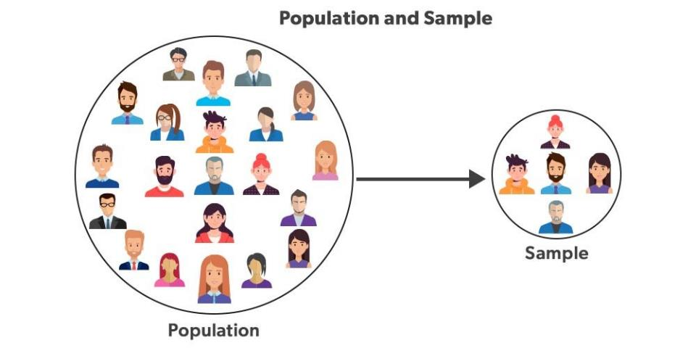

Slide 17
M = 3
M = 2
M = 3
M = 4
M = 3

Slide 18
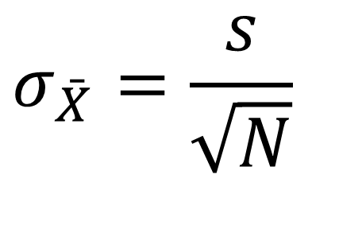
Population Standard Error Formula
$$σ_{\bar{X}}=\frac{s}{\sqrt{N}}$$
Notes:
Why are we dividing by the sample size?

Slide 19
Degrees of Freedom

Slide 20
Types of Hypotheses
Null hypothesis, H₀
  There is no effect.
  e.g. Big Brother contestants and members of the public will not differ in their scores on personality disorder questionnaires
The alternative hypothesis, H₁
  Aka the experimental hypothesis
  E.g. Big Brother contestants will score higher on personality disorder questionnaires than members of the public

Slide 21
p-values (1)
p‑value: the probability of observing data at least as extreme as your sample, assuming the null hypothesis (H₀) is true
Hypothesis testing role: You compare the p‑value to a chosen significance level α (commonly 0.05). If p ≤ α, you reject H₀; if p > α, you fail to reject H₀ .
A p‑value does not:
Measure the probability that H₀ is true!
Tell you how big the effect is! .

Slide 22
p-values (2)
Misconception 1: A significant result means that the effect is important
  No, because significance depends on sample size.
Misconception 2: A non-significant result means that the null hypothesis is true
  No, a non-significant result tells us only that the effect is not big enough to be found (given our sample size); it doesn’t tell us that the effect size is zero.
Misconception 3: A significant result means that the null hypothesis is false?
  No, it is logically not possible to conclude this.

Slide 23
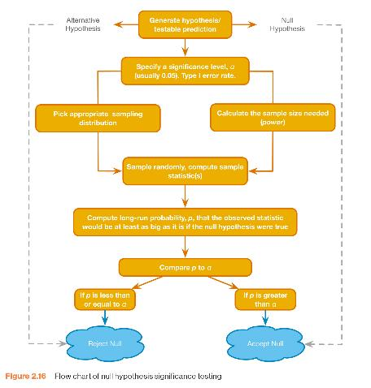

Slide 24
Test Statistics
A statistic for which the frequency of particular values is known.
Observed values can be used to test hypotheses.
$$\text{Test} \text{Statistic}=\frac{\text{signal}}{\text{noise}}=\frac{\text{variance} \text{explained} \text{by} \text{the} \text{model}}{\text{variance} \text{not} \text{explained} \text{by} \text{the} \text{model}}=\frac{\text{effect}}{\text{error}}$$

Slide 25
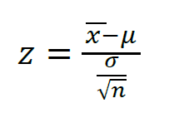
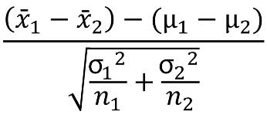
The z-test
One sample: Tests for a significant difference between a sample mean and a population mean when the population standard deviation is known.
Two sample: Compare the means of two independent samples when the population standard deviations are known

Slide 26
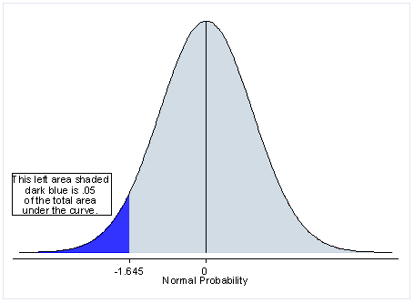
One- and Two-Tailed Tests (1)

Slide 27
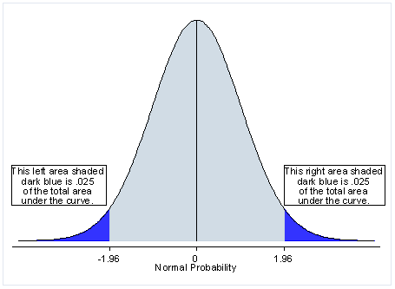
One- and Two-Tailed Tests (2)

Slide 28
Test Statistics and Distributions
Remember that the normal distribution is just a fancy histogram (frequency distribution)
Can use this to estimate the probability of finding any value (assuming the value is normally distributed to begin with)
Most values are centered around the mean (this is why the middle of the chart rises up)

Slide 29
Type I and Type II Errors
Type I error
  Occurs when we believe that there is a genuine effect in our population, when in fact there isn’t.
  The probability is the α-level (usually 0.05)
Type II error
  Occurs when we believe that there is no effect in the population when, in reality, there is.
  The probability is the β-level (often 0.2)

